Slide 1

Chapter 9 – Interfaces and Polymorphism
Big Java by Cay Horstmann
Copyright © 2009 by John Wiley & Sons. All rights reserved.

Slide 2
Chapter Goals
To be able to declare and use interface types
To understand the concept of polymorphism
To appreciate how interfaces can be used to decouple classes
To learn how to implement helper classes as inner classes
G To implement event listeners in graphical applications

Slide 3
Using Interfaces for Algorithm Reuse
Use interface types to make code more reusable
In Chapter 6, we created a DataSet to find the average and maximum of a set of numbers
What if we want to find the average and maximum of a set of BankAccount values?

Slide 4
Using Interfaces for Algorithm Reuse
public class DataSet // Modified for BankAccount objects {
private double sum;
private BankAccount maximum;
private int count;
...
public void add(BankAccount x)
{
sum = sum + x.getBalance();
if (count == 0 || maximum.getBalance() < x.getBalance())
maximum = x;
count++;
}
public BankAccount getMaximum()
{
return maximum;
}
}

Slide 5
Using Interfaces for Algorithm Reuse
Or suppose we wanted to find the coin with the highest value among a set of coins. We would need to modify the DataSet class again:
public class DataSet // Modified for Coin objects
{
private double sum;
private Coin maximum;
private int count;
...
public void add(Coin x)
{
sum = sum + x.getValue();
if (count == 0 || maximum.getValue() <
x.getValue()) maximum = x;
count++;
}

Slide 6
Using Interfaces for Algorithm Reuse
public Coin getMaximum()
{
return maximum;
}
}

Slide 7
Using Interfaces for Algorithm Reuse
The algorithm for the data analysis service is the same in all cases; details of measurement differ
Classes could agree on a method getMeasure that obtains the measure to be used in the analysis
We can implement a single reusable DataSet class whose add method looks like this:
sum = sum + x.getMeasure();
if (count == 0 || maximum.getMeasure() < x.getMeasure())
maximum = x;
count++;

Slide 8
Using Interfaces for Algorithm Reuse
What is the type of the variable x?
  x should refer to any class that has a getMeasure method
In Java, an interface type is used to specify required operations:
  public interface Measurable
  {
  double getMeasure();
  }
Interface declaration lists all methods that the interface type requires

Slide 9
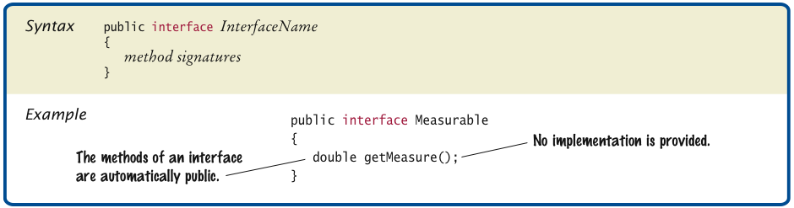
Syntax 9.1 Declaring an Interface
Big Java by Cay Horstmann
Copyright © 2009 by John Wiley & Sons. All rights reserved.

Slide 10
Interfaces vs. Classes
An interface type is similar to a class, but there are several important differences:
  All methods in an interface type are abstract; they don’t have an implementation
  All methods in an interface type are automatically public
  An interface type does not have instance fields

Slide 11
Generic DataSet for Measurable Objects
public class DataSet
{
private double sum;
private Measurable maximum;
private int count;
...
public void add(Measurable x)
{
sum = sum + x.getMeasure();
if (count == 0 || maximum.getMeasure() < x.getMeasure())
maximum = x;
count++;
}
public Measurable getMaximum()
{
return maximum;
}
}

Slide 12
Implementing an Interface Type
Use implements reserved word to indicate that a class implements an interface type:
  public class BankAccount implements Measurable
  {
  public double getMeasure()
  {
  ...
  return balance;
  }
  }
A class can implement more than one interface type
  Class must declare all the methods that are required by all the interfaces it implements

Slide 13
Implementing an Interface Type
Another example:
public class Coin implements Measurable
{
public double getMeasure()
{
return value;
}
...
}

Slide 14
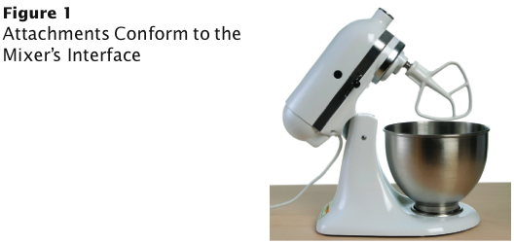
Code Reuse
A service type such as DataSet specifies an interface for participating in the service
Use interface types to make code more reusable

Slide 15
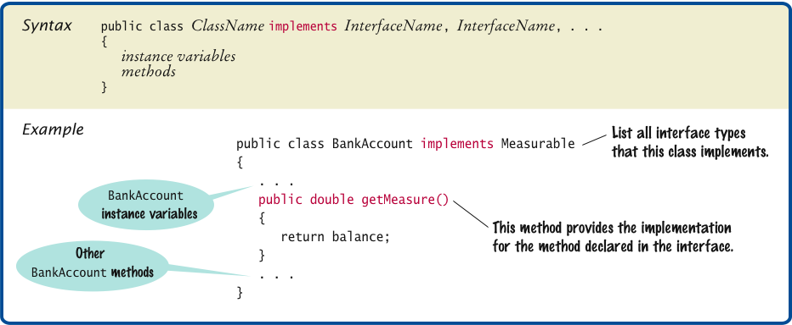
Syntax 9.2 Implementing an Interface

Slide 16
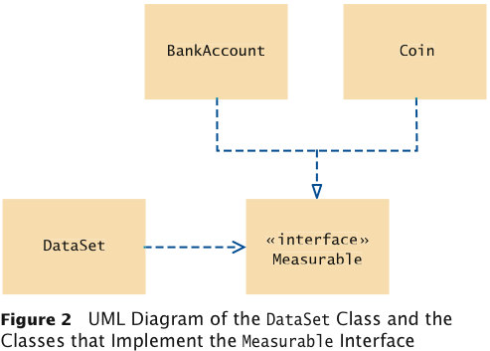
UML Diagram of DataSet and Related Classes
Interfaces can reduce the coupling between classes
UML notation:
  Interfaces are tagged with a “stereotype” indicator «interface»
  A dotted arrow with a triangular tip denotes the “is-a” relationship between a class and an interface
  A dotted line with an open v-shaped arrow tip denotes the “uses” relationship or dependency
Note that DataSet is decoupled from
BankAccount and Coin

Slide 17
ch09/measure1/DataSetTester.java
1 /**
2 This program tests the DataSet class.
3 */
4 public class DataSetTester
5 {
6 public static void main(String[] args)
7 {
8 DataSet bankData = new DataSet();
9
10 bankData.add(new BankAccount(0));
11 bankData.add(new BankAccount(10000));
12 bankData.add(new BankAccount(2000));
13
14 System.out.println("Average balance: " + bankData.getAverage());
15 System.out.println("Expected: 4000");
16 Measurable max = bankData.getMaximum();
17 System.out.println("Highest balance: " + max.getMeasure());
18 System.out.println("Expected: 10000");
19
20 DataSet coinData = new DataSet();
21
Continued

Slide 18
ch09/measure1/DataSetTester.java (cont.)
22 coinData.add(new Coin(0.25, "quarter"));
23 coinData.add(new Coin(0.1, "dime"));
24 coinData.add(new Coin(0.05, "nickel"));
25
26 System.out.println("Average coin value: " + coinData.getAverage());
27 System.out.println("Expected: 0.133");
28 max = coinData.getMaximum();
29 System.out.println("Highest coin value: " + max.getMeasure());
30 System.out.println("Expected: 0.25");
31 }
32 }

Slide 19
ch09/measure1/DataSetTester.java (cont.)
Program Run:
  Average balance: 4000.0
  Expected: 4000
  Highest balance: 10000.0
  Expected: 10000
  Average coin value: 0.13333333333333333
  Expected: 0.133
  Highest coin value: 0.25
  Expected: 0.25

Slide 20
Self Check 9.1
Suppose you want to use the DataSet class to find the Country object with the largest population. What condition must the Country class fulfill?
  Answer: It must implement the Measurable interface, and its getMeasure method must return the population.

Slide 21
Self Check 9.2
Why can’t the add method of the DataSet class have a parameter of type Object?
  Answer: The Object class doesn’t have a getMeasure method, and the add method invokes the getMeasure method.

Slide 22
Converting Between Class and Interface Types
You can convert from a class type to an interface type, provided
the class implements the interface
BankAccount account = new BankAccount(10000);
Measurable x = account; // OK
Coin dime = new Coin(0.1, "dime");
Measurable x = dime; // Also OK
Cannot convert between unrelated types:
  Measurable x = new Rectangle(5, 10, 20, 30); // ERROR
Because Rectangle doesn’t implement Measurable

Slide 23
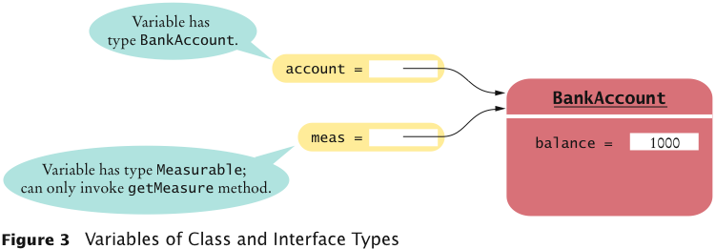
Variables of Class and Interface Types

Slide 24
Casts
Add Coin objects to DataSet:
DataSet coinData = new DataSet();
coinData.add(new Coin(0.25, "quarter"));
coinData.add(new Coin(0.1, "dime"));
coinData.add(new Coin(0.05, ”nickel"));
Measurable max = coinData.getMaximum(); // Get the largest coin
What can you do with max? It’s not of type Coin:
  String name = max.getName(); // ERROR
You need a cast to convert from an interface type to a class type
You know it’s a Coin, but the compiler doesn’t. Apply a cast:
  Coin maxCoin = (Coin) max;
  String name = maxCoin.getName();

Slide 25
Casts
If you are wrong and max isn’t a coin, the program throws an exception and terminates
Difference with casting numbers:
  When casting number types you agree to the information loss
  When casting object types you agree to that risk of causing an exception

Slide 26
Self Check 9.3
Can you use a cast (BankAccount) x to convert a Measurable variable x to a BankAccount reference?
  Answer: Only if x actually refers to a BankAccount object.

Slide 27
Self Check 9.4
If both BankAccount and Coin implement the Measurable interface, can a Coin reference be converted to a BankAccount reference?
  Answer: No — a Coin reference can be converted to a Measurable reference, but if you attempt to cast that reference to a BankAccount, an exception occurs.

Slide 28
Polymorphism
An interface variable holds a reference to object of a class that implements the interface:
  Measurable meas;
  meas = new BankAccount(10000);
  meas = new Coin(0.1, "dime");
Note that the object to which meas refers doesn’t have type Measurable; the type of the object is some class that implements the Measurable interface
You can call any of the interface methods:
  double m = meas.getMeasure();
Which method is called?

Slide 29
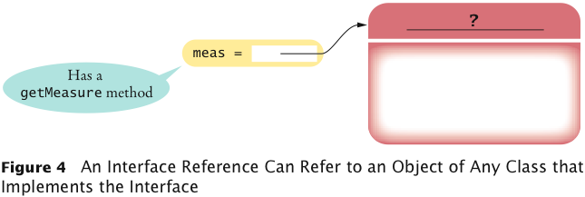
Interface Reference

Slide 30
Polymorphism
When the virtual machine calls an instance method, it locates the method of the implicit parameter's class — called dynamic method lookup
If meas refers to a BankAccount object, then meas.getMeasure() calls the BankAccount.getMeasure method
If meas refers to a Coin object, then method Coin.getMeasure is called
Polymorphism (many shapes) denotes the ability to treat objects with differences in behavior in a uniform way

Slide 31
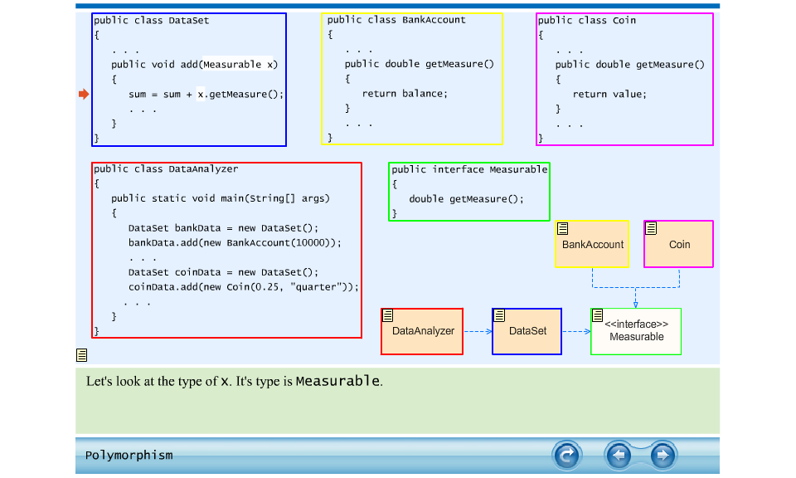
Animation 9.1: Polymorphism

Slide 32
Self Check 9.5
Why is it impossible to construct a Measurable object?
  Answer: Measurable is an interface. Interfaces have no fields and no method implementations.

Slide 33
Self Check 9.6
Why can you nevertheless declare a variable whose type is Measurable?
  Answer: That variable never refers to a Measurable object. It refers to an object of some class — a class that implements the Measurable interface.

Slide 34
Self Check 9.7
What does this code fragment print? Why is this an example of polymorphism?
DataSet data = new DataSet();
data.add(new BankAccount(1000));
data.add(new Coin(0.1, "dime"));
System.out.println(data.getAverage());
  Answer: The code fragment prints 500.05. Each call to add results in a call x.getMeasure(). In the first call, x is a BankAccount. In the second call, x is a Coin. A different getMeasure method is called in each case. The first call returns the account balance, the second one the coin value.

Slide 35
Using Interfaces for Callbacks
Limitations of Measurable interface:
  Can add Measurable interface only to classes under your control
  Can measure an object in only one way
  E.g., cannot analyze a set of savings accounts both by bank balance and by interest rate
Callback: a mechanism for specifying code that is executed at a later time
In previous DataSet implementation, responsibility of measuring lies with the added objects themselves

Slide 36
Using Interfaces for Callbacks
Alternative: Hand the object to be measured to a method of an interface:
  public interface Measurer
  {
  double measure(Object anObject);
  }
Object is the “lowest common denominator” of all classes

Slide 37
Using Interfaces for Callbacks
  The code that makes the call to the callback receives an object of class that implements this interface:
    public DataSet(Measurer aMeasurer)
    {
    sum = 0;
    count = 0;
    maximum = null;
    measurer = aMeasurer; // Measurer instance variable
    }
  The measurer instance variable carries out the measurements:
    public void add(Object x)
    {
    sum = sum + measurer.measure(x);
    if (count == 0 || measurer.measure(maximum) < measurer.measure(x))
    maximum = x;
    count++;
    }

Slide 38
Using Interfaces for Callbacks
A specific callback is obtained by implementing the Measurer interface:
public class RectangleMeasurer implements Measurer
{
public double measure(Object anObject)
{
Rectangle aRectangle = (Rectangle) anObject;
double area = aRectangle.getWidth() *
aRectangle.getHeight();
return area;
}
}
Must cast from Object to Rectangle:
Rectangle aRectangle = (Rectangle) anObject;

Slide 39
Using Interfaces for Callbacks
Pass measurer to data set constructor:
Measurer m = new RectangleMeasurer();
DataSet data = new DataSet(m);
data.add(new Rectangle(5, 10, 20, 30));
data.add(new Rectangle(10, 20, 30, 40));
...

Slide 40
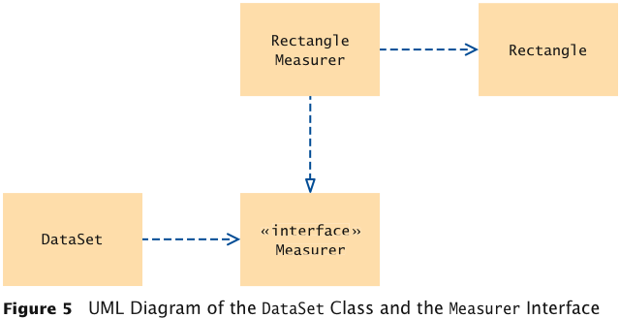
UML Diagram of Measurer Interface and Related Classes
Note that the Rectangle class is decoupled from the Measurer interface

Slide 41
ch09/measure2/Measurer.java
1 /**
2 Describes any class whose objects can measure other objects.
3 */
4 public interface Measurer
5 {
6 /**
7 Computes the measure of an object.
8 @param anObject the object to be measured
9 @return the measure
10 */
11 double measure(Object anObject);
12 }

Slide 42
ch09/measure2/RectangleMeasurer.java
1 import java.awt.Rectangle;
2
3 /**
4 Objects of this class measure rectangles by area.
5 */
6 public class RectangleMeasurer implements Measurer
7 {
8 public double measure(Object anObject)
9 {
10 Rectangle aRectangle = (Rectangle) anObject;
11 double area = aRectangle.getWidth() * aRectangle.getHeight();
12 return area;
13 }
14 }

Slide 43
ch09/measure2/DataSet.java
1 /**
2 Computes the average of a set of data values.
3 */
4 public class DataSet
5 {
6 private double sum;
7 private Object maximum;
8 private int count;
9 private Measurer measurer;
10
11 /**
12 Constructs an empty data set with a given measurer.
13 @param aMeasurer the measurer that is used to measure data values
14 */
15 public DataSet(Measurer aMeasurer)
16 {
17 sum = 0;
18 count = 0;
19 maximum = null;
20 measurer = aMeasurer;
21 }
22
Continued

Slide 44
ch09/measure2/DataSet.java (cont.)
23 /**
24 Adds a data value to the data set.
25 @param x a data value
26 */
27 public void add(Object x)
28 {
29 sum = sum + measurer.measure(x);
30 if (count == 0 || measurer.measure(maximum) < measurer.measure(x))
31 maximum = x;
32 count++;
33 }
34
35 /**
36 Gets the average of the added data.
37 @return the average or 0 if no data has been added
38 */
39 public double getAverage()
40 {
41 if (count == 0) return 0;
42 else return sum / count;
43 }
44
Continued

Slide 45
ch09/measure2/DataSet.java (cont.)
45 /**
46 Gets the largest of the added data.
47 @return the maximum or 0 if no data has been added
48 */
49 public Object getMaximum()
50 {
51 return maximum;
52 }
53 }

Slide 46
ch09/measure2/DataSetTester2.java
1 import java.awt.Rectangle;
2
3 /**
4 This program demonstrates the use of a Measurer.
5 */
6 public class DataSetTester2
7 {
8 public static void main(String[] args)
9 {
10 Measurer m = new RectangleMeasurer();
11
12 DataSet data = new DataSet(m);
13
14 data.add(new Rectangle(5, 10, 20, 30));
15 data.add(new Rectangle(10, 20, 30, 40));
16 data.add(new Rectangle(20, 30, 5, 15));
17
18 System.out.println("Average area: " + data.getAverage());
19 System.out.println("Expected: 625");
20
Continued

Slide 47
ch09/measure2/DataSetTester2.java (cont.)
21 Rectangle max = (Rectangle) data.getMaximum();
22 System.out.println("Maximum area rectangle: " + max);
23 System.out.println("Expected: "
24 + "java.awt.Rectangle[x=10,y=20,width=30,height=40]");
25 }
26 }
Program Run:
Average area: 625
Expected: 625
Maximum area rectangle:java.awt.Rectangle[x=10,y=20,width=30,height=40]
Expected: java.awt.Rectangle[x=10,y=20,width=30,height=40]

Slide 48
Self Check 9.8
Suppose you want to use the DataSet class of Section 9.1 to find the longest String from a set of inputs. Why can’t this work?
  Answer: The String class doesn’t implement the Measurable interface.

Slide 49
Self Check 9.9
How can you use the DataSet class of this section to find the longest String from a set of inputs?
  Answer: Implement a class StringMeasurer that implements the Measurer interface.

Slide 50
Self Check 9.10
Why does the measure method of the Measurer interface have one more parameter than the getMeasure method of the Measurable interface?
  Answer: A measurer measures an object, whereas getMeasure measures “itself”, that is, the implicit parameter.

Slide 51
Inner Classes
Trivial class can be declared inside a method:
  public class DataSetTester3
  {
  public static void main(String[] args)
  {
  class RectangleMeasurer implements Measurer
  {
  ...
  }
  Measurer m = new RectangleMeasurer();
  DataSet data = new DataSet(m);
  ...
  }
  }

Slide 52
Inner Classes
If inner class is declared inside an enclosing class, but outside its methods, it is available to all methods of enclosing class:
  public class DataSetTester3
  {
  class RectangleMeasurer implements Measurer
  {
  . . .
  }
  public static void main(String[] args)
  {
  Measurer m = new RectangleMeasurer();
  DataSet data = new DataSet(m);
  . . .
  }
  }

Slide 53
Inner Classes
Compiler turns an inner class into a regular class file:
  DataSetTester$1$RectangleMeasurer.class

Slide 54
ch09/measure3/DataSetTester3.java
1 import java.awt.Rectangle;
2
3 /**
4 This program demonstrates the use of an inner class.
5 */
6 public class DataSetTester3
7 {
8 public static void main(String[] args)
9 {
10 class RectangleMeasurer implements Measurer
11 {
12 public double measure(Object anObject)
13 {
14 Rectangle aRectangle = (Rectangle) anObject;
15 double area
16 = aRectangle.getWidth() * aRectangle.getHeight();
17 return area;
18 }
19 }
20
21 Measurer m = new RectangleMeasurer();
22
23 DataSet data = new DataSet(m);
24
Continued

Slide 55
ch09/measure3/DataSetTester3.java (cont.)
25 data.add(new Rectangle(5, 10, 20, 30));
26 data.add(new Rectangle(10, 20, 30, 40));
27 data.add(new Rectangle(20, 30, 5, 15));
28
29 System.out.println("Average area: " + data.getAverage());
30 System.out.println("Expected: 625");
31
32 Rectangle max = (Rectangle) data.getMaximum();
33 System.out.println("Maximum area rectangle: " + max);
34 System.out.println("Expected: "
35 + "java.awt.Rectangle[x=10,y=20,width=30,height=40]");
36 }
37 }

Slide 56
Self Check 9.11
Why would you use an inner class instead of a regular class?
  Answer: Inner classes are convenient for insignificant classes. Also, their methods can access variables and fields from the surrounding scope.

Slide 57
Self Check 9.12
How many class files are produced when you compile the DataSetTester3 program?
  Answer: Four: one for the outer class, one for the inner class, and two for the DataSet and Measurer classes.

Slide 58
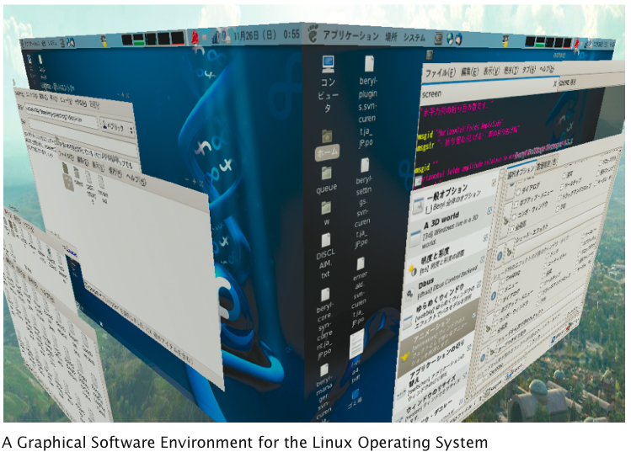
Operating Systems

Slide 59
Mock Objects
Want to test a class before the entire program has been completed
A mock object provides the same services as another object, but in a simplified manner
Example: a grade book application, GradingProgram, manages quiz scores using class GradeBook with methods:
  public void addScore(int studentId, double score)
  public double getAverageScore(int studentId)
  public void save(String filename)
Want to test GradingProgram without having a fully functional GradeBook class
Big Java by Cay Horstmann
Copyright © 2009 by John Wiley & Sons. All rights reserved.

Slide 60
Mock Objects
Declare an interface type with the same methods that the GradeBook class provides
  Convention: use the letter I as a prefix for the interface name:
    public interface IGradeBook
    {
    void addScore(int studentId, double score);
    double getAverageScore(int studentId);
    void save(String filename);
    . . .
    }
The GradingProgram class should only use this interface, never the GradeBook class which implements this interface
Big Java by Cay Horstmann
Copyright © 2009 by John Wiley & Sons. All rights reserved.

Slide 61
Mock Objects
Meanwhile, provide a simplified mock implementation, restricted to the case of one student and without saving functionality:
  public class MockGradeBook implements IGradeBook
  {
  private ArrayList<Double> scores;
  public void addScore(int studentId, double score)
  {
  // Ignore studentId
  scores.add(score);
  }
  double getAverageScore(int studentId)
  {
  double total = 0;
  for (double x : scores) { total = total + x; }
  return total / scores.size();
  }
  void save(String filename)
  {
  // Do nothing
  }
  . . .
  }
Big Java by Cay Horstmann
Copyright © 2009 by John Wiley & Sons. All rights reserved.

Slide 62
Mock Objects
Now construct an instance of MockGradeBook and use it immediately to test the GradingProgram class
When you are ready to test the actual class, simply use a GradeBook instance instead
Don’t erase the mock class — it will still come in handy for regression testing
Big Java by Cay Horstmann
Copyright © 2009 by John Wiley & Sons. All rights reserved.

Slide 63
Self Check 9.13
Why is it necessary that the real class and the mock class implement the same interface type?
  Answer: You want to implement the GradingProgram class in terms of that interface so that it doesn’t have to change when you switch between the mock class and the actual class.

Slide 64
Self Check 9.14
Why is the technique of mock objects particularly effective when the GradeBook and GradingProgram class are developed by two programmers?
  Answer: Because the developer of GradingProgram doesn’t have to wait for the GradeBook class to be complete.

Slide 65
Events, Event Sources, and Event Listeners
User interface events include key presses, mouse moves, button clicks, and so on
Most programs don’t want to be flooded by boring events
A program can indicate that it only cares about certain specific events
Big Java by Cay Horstmann
Copyright © 2009 by John Wiley & Sons. All rights reserved.

Slide 66
Events, Event Sources, and Event Listeners
Event listener:
  Notified when event happens
  Belongs to a class that is provided by the application programmer
  Its methods describe the actions to be taken when an event occurs
  A program indicates which events it needs to receive by installing event listener objects
Event source:
  User interface component that generates a particular event
  Add an event listener object to the appropriate event source
  When an event occurs, the event source notifies all event listeners
Big Java by Cay Horstmann
Copyright © 2009 by John Wiley & Sons. All rights reserved.

Slide 67
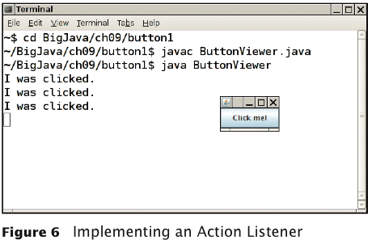
Events, Event Sources, and Event Listeners
Example: A program that prints a message whenever a button is clicked:
Big Java by Cay Horstmann
Copyright © 2009 by John Wiley & Sons. All rights reserved.

Slide 68
Events, Event Sources, and Event Listeners
Use JButton components for buttons; attach an ActionListener to each button
ActionListener interface:
public interface ActionListener
{
void actionPerformed(ActionEvent event);
}
Need to supply a class whose actionPerformed method
contains instructions to be executed when button is clicked
event parameter contains details about the event, such as the
time at which it occurred
Big Java by Cay Horstmann
Copyright © 2009 by John Wiley & Sons. All rights reserved.

Slide 69
Events, Event Sources, and Event Listeners
Construct an object of the listener and add it to the button:
  ActionListener listener = new ClickListener();
  button.addActionListener(listener);
Big Java by Cay Horstmann
Copyright © 2009 by John Wiley & Sons. All rights reserved.

Slide 70
ch09/button1/ClickListener.java
1 import java.awt.event.ActionEvent;
2 import java.awt.event.ActionListener;
3
4 /**
5 An action listener that prints a message.
6 */
7 public class ClickListener implements ActionListener
8 {
9 public void actionPerformed(ActionEvent event)
10 {
11 System.out.println("I was clicked.");
12 }
13 }
Big Java by Cay Horstmann
Copyright © 2009 by John Wiley & Sons. All rights reserved.

Slide 71
ch09/button1/ButtonViewer.java
1 import java.awt.event.ActionListener;
2 import javax.swing.JButton;
3 import javax.swing.JFrame;
4
5 /**
6 This program demonstrates how to install an action listener.
7 */
8 public class ButtonViewer
9 {
10 private static final int FRAME_WIDTH = 100;
11 private static final int FRAME_HEIGHT = 60;
12
13 public static void main(String[] args)
14 {
15 JFrame frame = new JFrame();
16 JButton button = new JButton("Click me!");
17 frame.add(button);
18
19 ActionListener listener = new ClickListener();
20 button.addActionListener(listener);
21
Continued
Big Java by Cay Horstmann
Copyright © 2009 by John Wiley & Sons. All rights reserved.

Slide 72
ch09/button1/ButtonViewer.java (cont.)
22 frame.setSize(FRAME_WIDTH, FRAME_HEIGHT);
23 frame.setDefaultCloseOperation(JFrame.EXIT_ON_CLOSE);
24 frame.setVisible(true);
25 }
26 }
Big Java by Cay Horstmann
Copyright © 2009 by John Wiley & Sons. All rights reserved.

Slide 73
Self Check 9.15
Which objects are the event source and the event listener in the ButtonViewer program?
  Answer: The button object is the event source. The listener object is the event listener.

Slide 74
Self Check 9.16
Why is it legal to assign a ClickListener object to a variable of type ActionListener?
  Answer: The ClickListener class implements the ActionListener interface.

Slide 75
Using Inner Classes for Listeners
Implement simple listener classes as inner classes like this:
JButton button = new JButton("...");
// This inner class is declared in the same method as the
// button variable
class MyListener implements ActionListener
{
...
};
ActionListener listener = new MyListener(); button.addActionListener(listener);
This places the trivial listener class exactly where it is needed, without cluttering up the remainder of the project
Big Java by Cay Horstmann
Copyright © 2009 by John Wiley & Sons. All rights reserved.

Slide 76
Using Inner Classes for Listeners
Methods of an inner class can access the variables from the enclosing scope
  Local variables that are accessed by an inner class method must be declared as final
Example: Add interest to a bank account whenever a button is clicked:
Big Java by Cay Horstmann
Copyright © 2009 by John Wiley & Sons. All rights reserved.

Slide 77
Using Inner Classes for Listeners
JButton button = new JButton("Add Interest");
final BankAccount account =
new BankAccount(INITIAL_BALANCE);
// This inner class is declared in the same method as
// the account and button variables.
class AddInterestListener implements ActionListener
{
public void actionPerformed(ActionEvent event)
{
// The listener method accesses the account
// variable from the surrounding block
double interest = account.getBalance()
* INTEREST_RATE / 100;
account.deposit(interest);
}
};
ActionListener listener = new AddInterestListener();
button.addActionListener(listener);
Big Java by Cay Horstmann
Copyright © 2009 by John Wiley & Sons. All rights reserved.

Slide 78
ch09/button2/InvestmentViewer1.java
1 import java.awt.event.ActionEvent;
2 import java.awt.event.ActionListener;
3 import javax.swing.JButton;
4 import javax.swing.JFrame;
5
6 /**
7 This program demonstrates how an action listener can access
8 a variable from a surrounding block.
9 */
10 public class InvestmentViewer1
11 {
12 private static final int FRAME_WIDTH = 120;
13 private static final int FRAME_HEIGHT = 60;
14
15 private static final double INTEREST_RATE = 10;
16 private static final double INITIAL_BALANCE = 1000;
17
18 public static void main(String[] args)
19 {
20 JFrame frame = new JFrame();
21
Continued
Big Java by Cay Horstmann
Copyright © 2009 by John Wiley & Sons. All rights reserved.

Slide 79
ch09/button2/InvestmentViewer1.java (cont.)
22 // The button to trigger the calculation
23 JButton button = new JButton("Add Interest");
24 frame.add(button);
25
26 // The application adds interest to this bank account
27 final BankAccount account = new BankAccount(INITIAL_BALANCE);
28
29 class AddInterestListener implements ActionListener
30 {
31 public void actionPerformed(ActionEvent event)
32 {
33 // The listener method accesses the account variable
34 // from the surrounding block
35 double interest = account.getBalance() * INTEREST_RATE / 100;
36 account.deposit(interest);
37 System.out.println("balance: " + account.getBalance());
38 }
39 }
40
Continued
Big Java by Cay Horstmann
Copyright © 2009 by John Wiley & Sons. All rights reserved.

Slide 80
ch09/button2/InvestmentViewer1.java (cont.)
41 ActionListener listener = new AddInterestListener();
42 button.addActionListener(listener);
43
44 frame.setSize(FRAME_WIDTH, FRAME_HEIGHT);
45 frame.setDefaultCloseOperation(JFrame.EXIT_ON_CLOSE);
46 frame.setVisible(true);
47 }
48 }
Program Run:
  balance: 1100.0
  balance: 1210.0
  balance: 1331.0
  balance: 1464.1
Big Java by Cay Horstmann
Copyright © 2009 by John Wiley & Sons. All rights reserved.

Slide 81
Self Check 9.17
Why would an inner class method want to access a variable from a surrounding scope?
  Answer: Direct access is simpler than the alternative — passing the variable as a parameter to a constructor or method.

Slide 82
Self Check 9.18
Why would an inner class method want to access a variable from a surrounding If an inner class accesses a local variable from a surrounding scope, what special rule applies?
  Answer: The local variable must be declared as final.

Slide 83
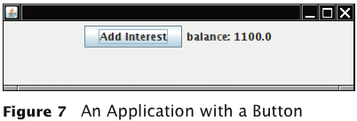
Building Applications with Buttons
Example: Investment viewer program; whenever button is clicked, interest is added, and new balance is displayed:
Big Java by Cay Horstmann
Copyright © 2009 by John Wiley & Sons. All rights reserved.

Slide 84
Building Applications with Buttons
Construct an object of the JButton class:
  JButton button = new JButton("Add Interest");
We need a user interface component that displays a message:
  JLabel label = new JLabel("balance: ”
  + account.getBalance());
Use a JPanel container to group multiple user interface components together:
  JPanel panel = new JPanel();
  panel.add(button);
  panel.add(label);
  frame.add(panel);
Big Java by Cay Horstmann
Copyright © 2009 by John Wiley & Sons. All rights reserved.

Slide 85
Building Applications with Buttons
Listener class adds interest and displays the new balance:
class AddInterestListener implements ActionListener
{
public void actionPerformed(ActionEvent event)
{
double interest = account.getBalance() *
INTEREST_RATE / 100;
account.deposit(interest);
label.setText("balance=" + account.getBalance());
}
}
Add AddInterestListener as inner class so it can have access to surrounding final variables (account and label)
Big Java by Cay Horstmann
Copyright © 2009 by John Wiley & Sons. All rights reserved.

Slide 86
ch09/button3/InvestmentViewer2.java
1 import java.awt.event.ActionEvent;
2 import java.awt.event.ActionListener;
3 import javax.swing.JButton;
4 import javax.swing.JFrame;
5 import javax.swing.JLabel;
6 import javax.swing.JPanel;
7 import javax.swing.JTextField;
8
9 /**
10 This program displays the growth of an investment.
11 */
12 public class InvestmentViewer2
13 {
14 private static final int FRAME_WIDTH = 400;
15 private static final int FRAME_HEIGHT = 100;
16
17 private static final double INTEREST_RATE = 10;
18 private static final double INITIAL_BALANCE = 1000;
19
20 public static void main(String[] args)
21 {
22 JFrame frame = new JFrame();
23
Continued
Big Java by Cay Horstmann
Copyright © 2009 by John Wiley & Sons. All rights reserved.

Slide 87
ch09/button3/InvestmentViewer2.java (cont.)
24 // The button to trigger the calculation
25 JButton button = new JButton("Add Interest");
26
27 // The application adds interest to this bank account
28 final BankAccount account = new BankAccount(INITIAL_BALANCE);
29
30 // The label for displaying the results
31 final JLabel label = new JLabel("balance: " + account.getBalance());
32
33 // The panel that holds the user interface components
34 JPanel panel = new JPanel();
35 panel.add(button);
36 panel.add(label);
37 frame.add(panel);
38
Continued
Big Java by Cay Horstmann
Copyright © 2009 by John Wiley & Sons. All rights reserved.

Slide 88
ch09/button3/InvestmentViewer2.java (cont.)
39 class AddInterestListener implements ActionListener
40 {
41 public void actionPerformed(ActionEvent event)
42 {
43 double interest = account.getBalance() * INTEREST_RATE / 100;
44 account.deposit(interest);
45 label.setText("balance: " + account.getBalance());
46 }
47 }
48
49 ActionListener listener = new AddInterestListener();
50 button.addActionListener(listener);
51
52 frame.setSize(FRAME_WIDTH, FRAME_HEIGHT);
53 frame.setDefaultCloseOperation(JFrame.EXIT_ON_CLOSE);
54 frame.setVisible(true);
55 }
56 }
Big Java by Cay Horstmann
Copyright © 2009 by John Wiley & Sons. All rights reserved.

Slide 89
Self Check 9.19
How do you place the "balance: ..." message to the left of the "Add Interest" button?
  Answer: First add label to the panel, then add button.

Slide 90
Self Check 9.20
Why was it not necessary to declare the button variable as final?
  Answer: The actionPerformed method does not access that variable.

Slide 91
Processing Timer Events
javax.swing.Timer generates equally spaced timer events, sending events to installed action listeners
Useful whenever you want to have an object updated in regular intervals
Big Java by Cay Horstmann
Copyright © 2009 by John Wiley & Sons. All rights reserved.

Slide 92
Processing Timer Events
Declare a class that implements the ActionListener interface:
class MyListener implements ActionListener
{
void actionPerformed(ActionEvent event)
{
Listener action (executed at each timer event)
}
}
Add listener to timer and start timer:
MyListener listener = new MyListener();
Timer t = new Timer(interval, listener);
t.start();
Big Java by Cay Horstmann
Copyright © 2009 by John Wiley & Sons. All rights reserved.

Slide 93
ch09/timer/RectangleComponent.java
Displays a rectangle that can be moved
The repaint method causes a component to repaint itself. Call this method whenever you modify the shapes that the paintComponent method draws
1 import java.awt.Graphics;
2 import java.awt.Graphics2D;
3 import java.awt.Rectangle;
4 import javax.swing.JComponent;
5
6 /**
7 This component displays a rectangle that can be moved.
8 */
9 public class RectangleComponent extends JComponent
10 {
11 private static final int BOX_X = 100;
12 private static final int BOX_Y = 100;
13 private static final int BOX_WIDTH = 20;
14 private static final int BOX_HEIGHT = 30;
15
Continued
Big Java by Cay Horstmann
Copyright © 2009 by John Wiley & Sons. All rights reserved.

Slide 94
ch09/timer/RectangleComponent.java (cont.)
16 private Rectangle box;
17
18 public RectangleComponent()
19 {
20 // The rectangle that the paintComponent method draws
21 box = new Rectangle(BOX_X, BOX_Y, BOX_WIDTH, BOX_HEIGHT);
22 }
23
24 public void paintComponent(Graphics g)
25 {
26 Graphics2D g2 = (Graphics2D) g;
27
28 g2.draw(box);
29 }
30
Continued
Big Java by Cay Horstmann
Copyright © 2009 by John Wiley & Sons. All rights reserved.

Slide 95
ch09/timer/RectangleComponent.java (cont.)
31 /**
32 Moves the rectangle by a given amount.
33 @param x the amount to move in the x-direction
34 @param y the amount to move in the y-direction
35 */
36 public void moveBy(int dx, int dy)
37 {
38 box.translate(dx, dy);
39 repaint();
40 }
41 }
Big Java by Cay Horstmann
Copyright © 2009 by John Wiley & Sons. All rights reserved.
Big Java by Cay Horstmann
Copyright © 2009 by John Wiley & Sons. All rights reserved.

Slide 96
ch09/timer/RectangleMover.java
1 import java.awt.event.ActionEvent;
2 import java.awt.event.ActionListener;
3 import javax.swing.JFrame;
4 import javax.swing.Timer;
5
6 /**
7 This program moves the rectangle.
8 */
9 public class RectangleMover
10 {
11 private static final int FRAME_WIDTH = 300;
12 private static final int FRAME_HEIGHT = 400;
13
14 public static void main(String[] args)
15 {
16 JFrame frame = new JFrame();
17
18 frame.setSize(FRAME_WIDTH, FRAME_HEIGHT);
19 frame.setTitle("An animated rectangle");
20 frame.setDefaultCloseOperation(JFrame.EXIT_ON_CLOSE);
21
Continued
Big Java by Cay Horstmann
Copyright © 2009 by John Wiley & Sons. All rights reserved.

Slide 97
ch09/timer/RectangleMover.java (cont.)
22 final RectangleComponent component = new RectangleComponent();
23 frame.add(component);
24
25 frame.setVisible(true);
26
27 class TimerListener implements ActionListener
28 {
29 public void actionPerformed(ActionEvent event)
30 {
31 component.moveBy(1, 1);
32 }
33 }
34
35 ActionListener listener = new TimerListener();
36
37 final int DELAY = 100; // Milliseconds between timer ticks
38 Timer t = new Timer(DELAY, listener);
39 t.start();
40 }
41 }
Big Java by Cay Horstmann
Copyright © 2009 by John Wiley & Sons. All rights reserved.

Slide 98
Self Check 9.21
Why does a timer require a listener object?
  Answer: The timer needs to call some method whenever the time interval expires. It calls the actionPerformed method of the listener object.

Slide 99
Self Check 9.22
What would happen if you omitted the call to repaint in the moveBy method?
  Answer: The moved rectangles won’t be painted, and the rectangle will appear to be stationary until the frame is repainted for an external reason.

Slide 100
Mouse Events
Use a mouse listener to capture mouse events
Implement the MouseListener interface:
  public interface MouseListener
  {
  void mousePressed(MouseEvent event);
  // Called when a mouse button has been pressed on a
  // component
  void mouseReleased(MouseEvent event);
  // Called when a mouse button has been released on a
  // component
  void mouseClicked(MouseEvent event);
  // Called when the mouse has been clicked on a component
  void mouseEntered(MouseEvent event);
  // Called when the mouse enters a component
  void mouseExited(MouseEvent event);
  // Called when the mouse exits a component
  }
Big Java by Cay Horstmann
Copyright © 2009 by John Wiley & Sons. All rights reserved.

Slide 101
Mouse Events
mousePressed, mouseReleased: Called when a mouse button is pressed or released
mouseClicked: If button is pressed and released in quick succession, and mouse hasn’t moved
mouseEntered, mouseExited: Mouse has entered or exited the component’s area
Big Java by Cay Horstmann
Copyright © 2009 by John Wiley & Sons. All rights reserved.

Slide 102
Mouse Events
Add a mouse listener to a component by calling the addMouseListener method:
public class MyMouseListener implements MouseListener
{
// Implements five methods
}
MouseListener listener = new MyMouseListener();
component.addMouseListener(listener);
Sample program: enhance RectangleComponent — when user clicks on rectangle component, move the rectangle
Big Java by Cay Horstmann
Copyright © 2009 by John Wiley & Sons. All rights reserved.

Slide 103
ch09/mouse/RectangleComponent.java
1 import java.awt.Graphics;
2 import java.awt.Graphics2D;
3 import java.awt.Rectangle;
4 import javax.swing.JComponent;
5
6 /**
7 This component displays a rectangle that can be moved.
8 */
9 public class RectangleComponent extends JComponent
10 {
11 private static final int BOX_X = 100;
12 private static final int BOX_Y = 100;
13 private static final int BOX_WIDTH = 20;
14 private static final int BOX_HEIGHT = 30;
15
16 private Rectangle box;
17
18 public RectangleComponent()
19 {
20 // The rectangle that the paintComponent method draws
21 box = new Rectangle(BOX_X, BOX_Y, BOX_WIDTH, BOX_HEIGHT);
22 }
23
Continued
Big Java by Cay Horstmann
Copyright © 2009 by John Wiley & Sons. All rights reserved.

Slide 104
ch09/mouse/RectangleComponent.java (cont.)
24 public void paintComponent(Graphics g)
25 {
26 Graphics2D g2 = (Graphics2D) g;
27
28 g2.draw(box);
29 }
30
31 /**
32 Moves the rectangle to the given location.
33 @param x the x-position of the new location
34 @param y the y-position of the new location
35 */
36 public void moveTo(int x, int y)
37 {
38 box.setLocation(x, y);
39 repaint();
40 }
41 }
Big Java by Cay Horstmann
Copyright © 2009 by John Wiley & Sons. All rights reserved.

Slide 105
Mouse Events
Call repaint when you modify the shapes that paintComponent draws:
  box.setLocation(x, y);
  repaint();
Big Java by Cay Horstmann
Copyright © 2009 by John Wiley & Sons. All rights reserved.

Slide 106
Mouse Events
Mouse listener: if the mouse is pressed, listener moves the rectangle to the mouse location:
  class MousePressListener implements MouseListener
  {
  public void mousePressed(MouseEvent event)
  {
  int x = event.getX();
  int y = event.getY();
  component.moveTo(x, y);
  }
  // Do-nothing methods
  public void mouseReleased(MouseEvent event) {}
  public void mouseClicked(MouseEvent event) {}
  public void mouseEntered(MouseEvent event) {}
  public void mouseExited(MouseEvent event) {}
  }
All five methods of the interface must be implemented; unused methods can be empty
Big Java by Cay Horstmann
Copyright © 2009 by John Wiley & Sons. All rights reserved.

Slide 107
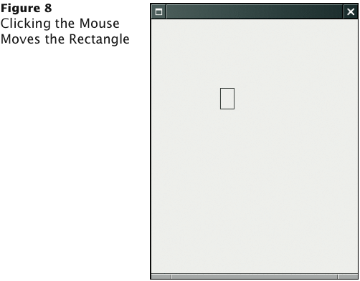
RectangleComponentViewer Program Run
Big Java by Cay Horstmann
Copyright © 2009 by John Wiley & Sons. All rights reserved.

Slide 108
ch09/mouse/RectangleComponentViewer.java
1 import java.awt.event.MouseListener;
2 import java.awt.event.MouseEvent;
3 import javax.swing.JFrame;
4
5 /**
6 This program displays a RectangleComponent.
7 */
8 public class RectangleComponentViewer
9 {
10 private static final int FRAME_WIDTH = 300;
11 private static final int FRAME_HEIGHT = 400;
12
13 public static void main(String[] args)
14 {
15 final RectangleComponent component = new RectangleComponent();
16
Continued
Big Java by Cay Horstmann
Copyright © 2009 by John Wiley & Sons. All rights reserved.

Slide 109
ch09/mouse/RectangleComponentViewer.java (cont.)
17 // Add mouse press listener
18
19 class MousePressListener implements MouseListener
20 {
21 public void mousePressed(MouseEvent event)
22 {
23 int x = event.getX();
24 int y = event.getY();
25 component.moveTo(x, y);
26 }
27
28 // Do-nothing methods
29 public void mouseReleased(MouseEvent event) {}
30 public void mouseClicked(MouseEvent event) {}
31 public void mouseEntered(MouseEvent event) {}
32 public void mouseExited(MouseEvent event) {}
33 }
34
35 MouseListener listener = new MousePressListener();
36 component.addMouseListener(listener);
37
Continued
Big Java by Cay Horstmann
Copyright © 2009 by John Wiley & Sons. All rights reserved.

Slide 110
ch09/mouse/RectangleComponentViewer.java (cont.)
38 JFrame frame = new JFrame();
39 frame.add(component);
40
41 frame.setSize(FRAME_WIDTH, FRAME_HEIGHT);
42 frame.setDefaultCloseOperation(JFrame.EXIT_ON_CLOSE);
43 frame.setVisible(true);
44 }
45 }
Big Java by Cay Horstmann
Copyright © 2009 by John Wiley & Sons. All rights reserved.

Slide 111
Self Check 9.23
Why was the moveBy method in the RectangleComponent replaced with a moveTo method?
  Answer: Because you know the current mouse position, not the amount by which the mouse has moved.

Slide 112
Self Check 9.24
Why must the MousePressListener class supply five methods?
  Answer: It implements the MouseListener interface, which has five methods.

